Slide 1



GET A LOAD OF THIS!
REALISTIC LOAD TESTING IN POWER BI
Matt Lakin
@datalakin
in/mattlakin
mattdatalakin.com

Slide 2






WHO’S THIS GUY?

Slide 3
WHAT’S ON THE MENU
What is Load Testing?
Why should we care?
How to load test in Power BI?
Realistic usage scenarios

Slide 4
OFF MENU
Troubleshooting / performance tuning
Licensing

Slide 5
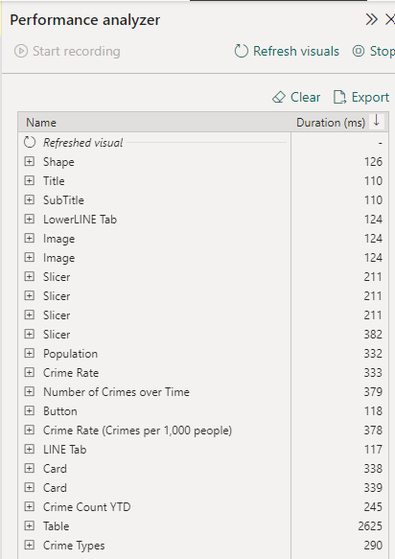
PERFORMANCE TESTING

Slide 6
PERFORMANCE TESTING
PERFORMANCE
STRESS
FLOOD
SPIKE
ENDURANCE
LOAD

Slide 7
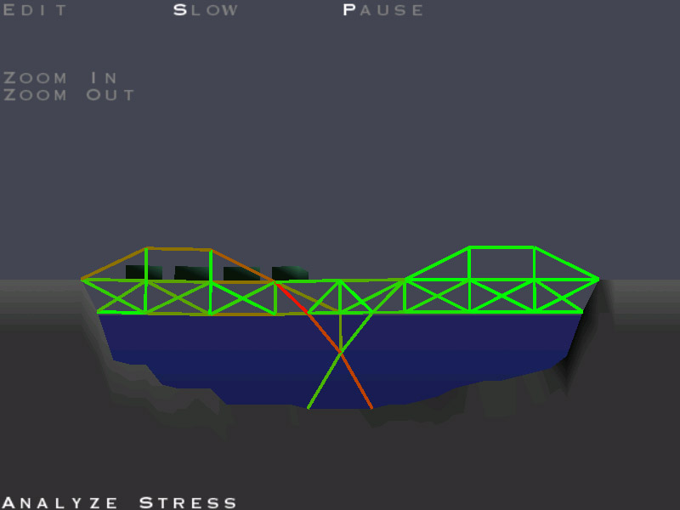
LOAD TESTING

Slide 8


LOAD TESTING VS STRESS TESTING
LOAD
STRESS
Specified load, typically “realistic” conditions
Predetermined parameters
Concurrent users / queries
Test type: pass or fail
Goal: test speed and reliability of a solution in a “real life” scenario
Unspecified load, typically starting low and increasing
Predetermined parameters
Concurrent users / queries
Test type: point of failure
Goal: find the load amount under which the solution fails

Slide 9
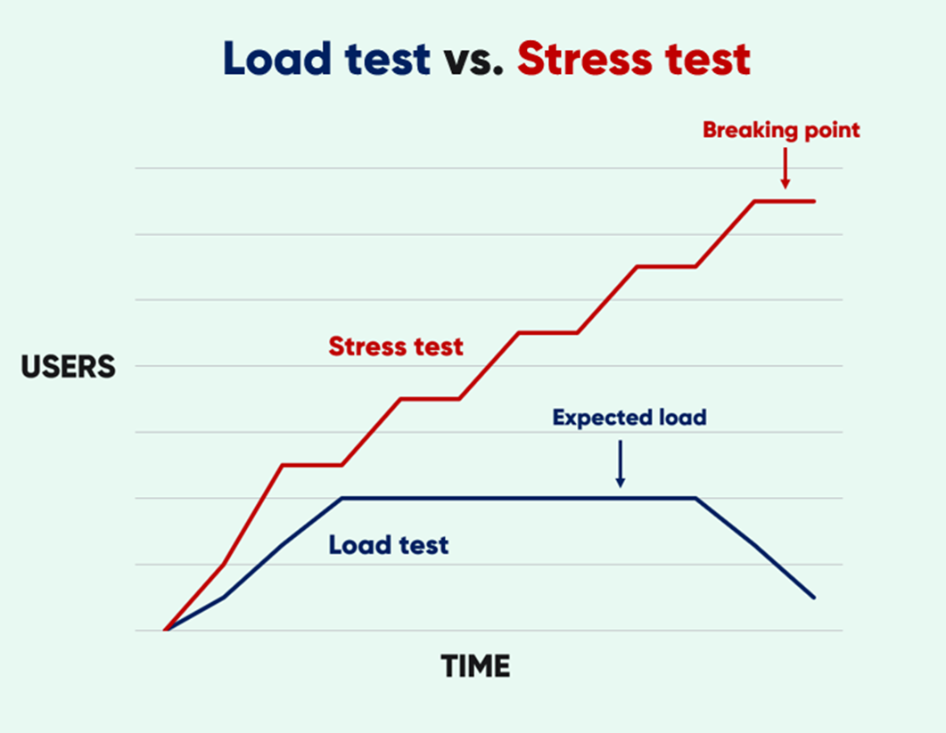
LOAD TESTING VS STRESS TESTING
Credit: queue-it.com

Slide 10
LOAD TESTING:
What it tests:
Front end report performance under varying load
“Realistic” report usage
What it doesn’t:
Individual query / DAX performance
Syntax, visual errors, access, security etc.

Slide 11

WHY SHOULD WE CARE?

Slide 12

WHY SHOULD WE CARE?
Production Pain
Commitment Issues
What the SKU?
Users ↑
Concurrent usage ↑
Data changes
Unreliable users
Production pain!
Adoption
Deployment, timeframes
Dependencies

Slide 13

WHY SHOULD WE CARE?
Production Pain
Commitment Issues
What the SKU?
Future code releases may affect performance
Data volume, logic changes, model size growth
Performance issues can be difficult to spot

Slide 14

WHY SHOULD WE CARE?
Production Pain
Commitment Issues
What the SKU?
Difficult to know what level of compute is needed
Test at various SKU levels (or make assumptions)
Benchmark & use as evidence
Scalability
Power BI Premium / Fabric
Live Connect / DQ data sources

Slide 15
LOAD IT UP
Assumptions:
There are no known significant inefficiencies / bottlenecks for 1 person usage
Dataset is import mode
All other variables can be (somewhat) controlled: data volume, background refreshes, CPU, network latency etc.

Slide 16
LOAD IT UP
SET CLEAR
OBJECTIVES
IDENTIFY REPORT USAGE
COMPARE SOLUTION OPTIONS
SET UP
DEFINE VARIABLES
RUN TESTS
ANALYSE RESULTS
EXECUTE

Slide 17
SOLUTION OPTIONS
DIY
AUTOMATE!
LOAD TEST PARTY

Slide 18
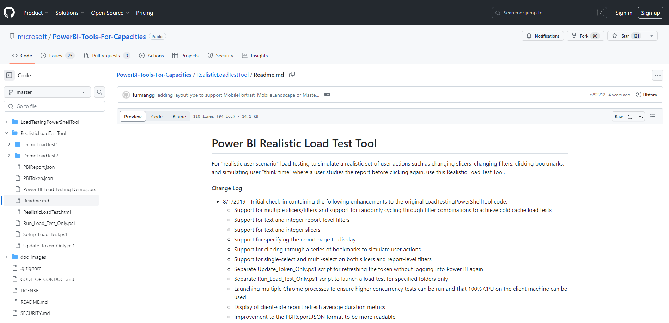
REALISTIC LOAD TEST TOOL
https://github.com/microsoft/PowerBI-Tools-For-Capacities

Slide 19
REALISTIC LOAD TEST TOOL
PowerShell based script
Replicate multiple users opening a browser window of your report
Preset parameters
Number of users
Number of views (refreshes)
Report pages
Filters
Bookmarks

Slide 20
REALISTIC LOAD TEST TOOL WHAT WILL YOU NEED?
PowerShell console with elevated access
Read access to workspace & report
Good enough CPU & Memory
Load Test Tool scripts
…and a healthy dose of enthusiasm

Slide 21
DEMO TIME
1. Realistic Load Test Tool 101
2. Realistic usage scenario
3. Capacity Planning
Notes:
How to use the tool
Realistic scenario – single report, Pro
Capacity testing
DirectLake?

Slide 22
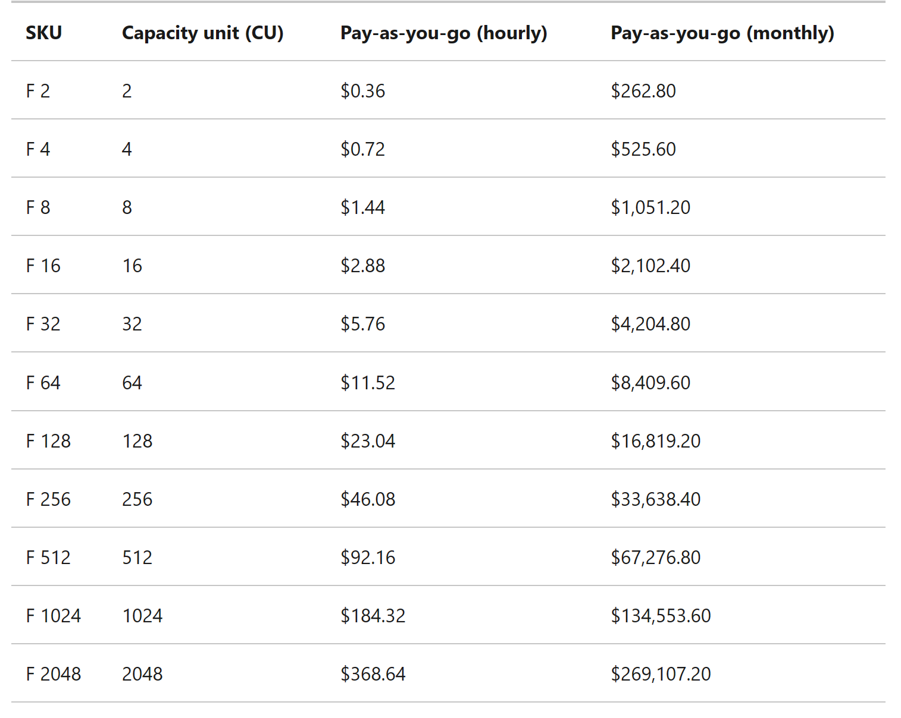
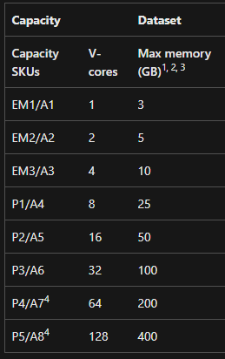
CAPACITY TESTING

Slide 23
CONSIDERATIONS
How good is your “realistic load” estimate?
Have you captured all relevant queries?
Does your machine have enough oomph? Consider using VMs
How “realistic” is your test environment?

Slide 24
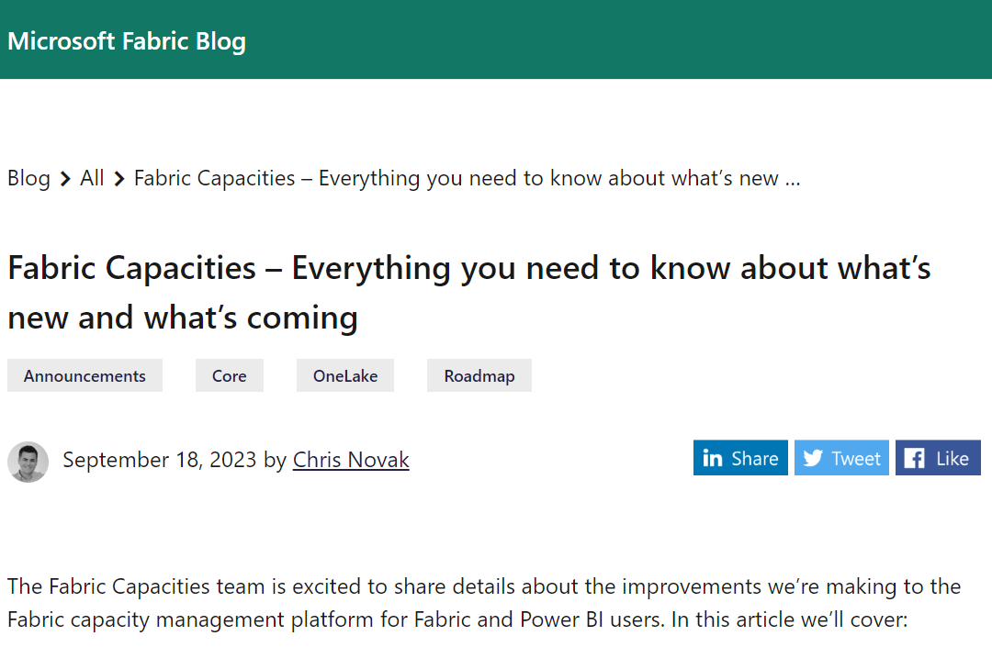
https://blog.fabric.microsoft.com/en-us/blog/fabric-capacities-everything-you-need-to-know-about-whats-new-and-whats-coming#

Slide 25
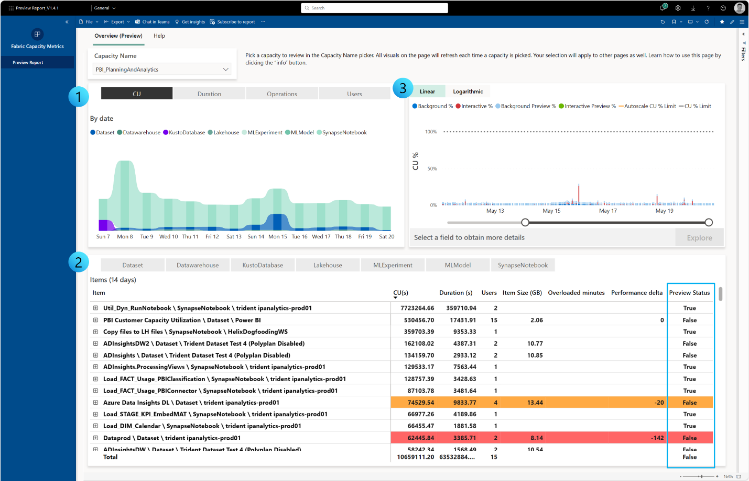
https://blog.fabric.microsoft.com/en-GB/blog/capacity-metrics-in-microsoft-fabric/

Slide 26
OTHER USE CASES
RLS
Regression Testing
DirectLake mode in Fabric

Slide 27
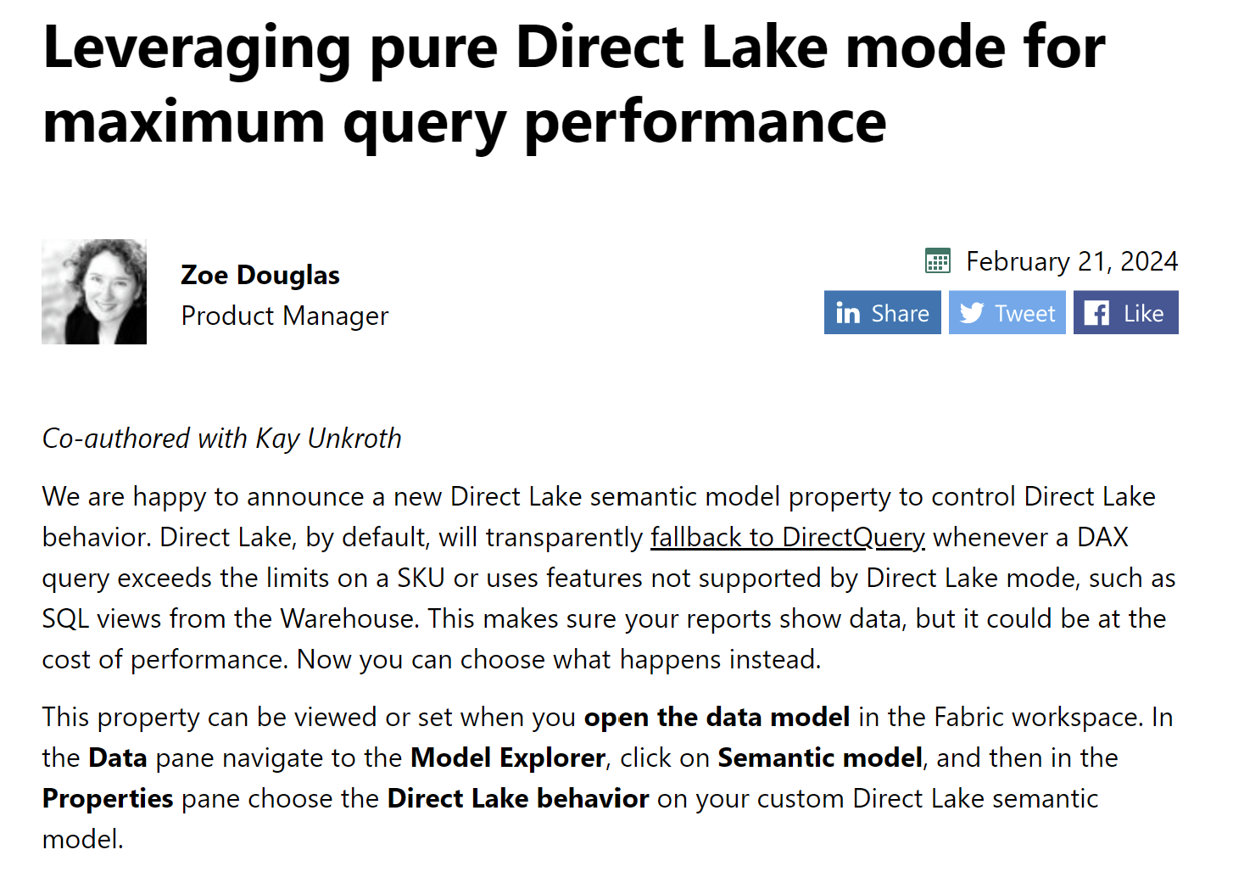
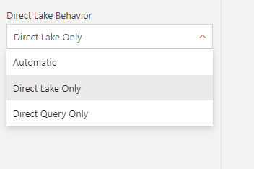
OTHER USE CASES

Slide 28
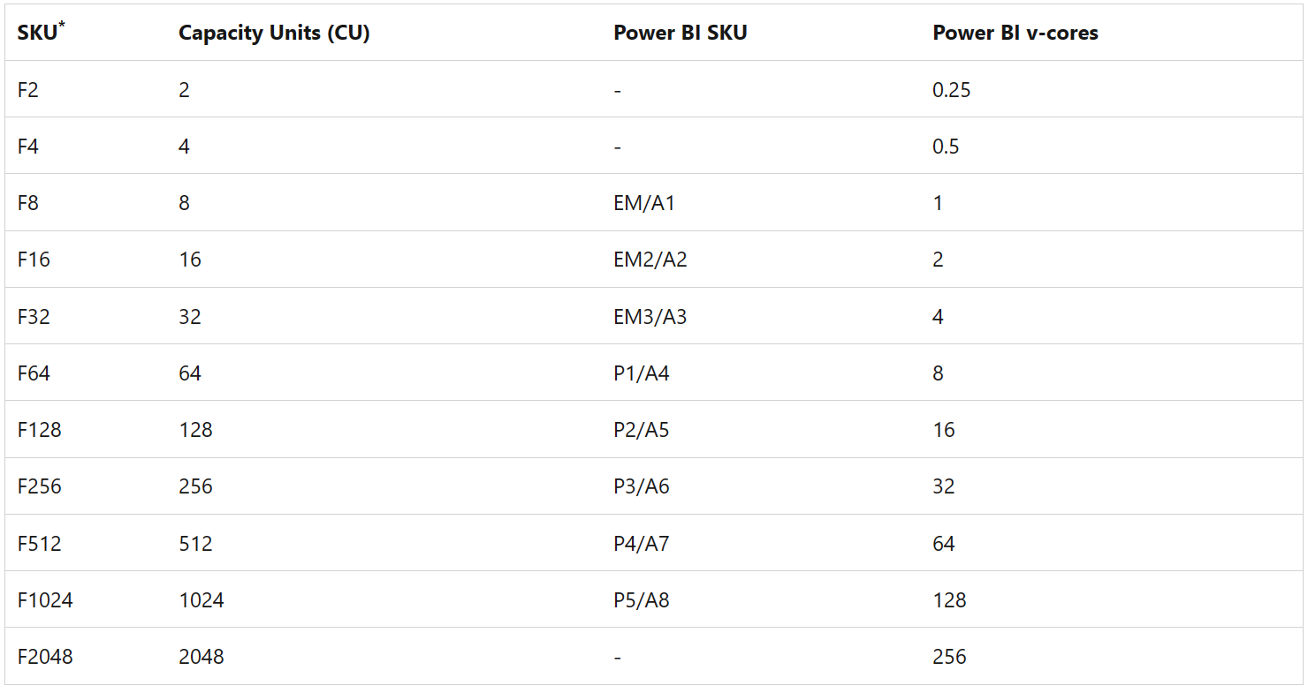
OTHER USE CASES

Slide 29
LIMITATIONS & IMPROVEMENTS
Local only
Low code / user friendly
DevOps: link PR IDs to load test runs
Combine with back end query results
Fabric

Slide 30
WHY WERE YOU HERE?
What is Load Testing?
Why should we care?
How to load test in Power BI?
Realistic usage scenarios

Slide 31

Any questions or feedback?
@datalakin
/in/mattlakin
datalakin
mattdatalakin.com
meetup.com/newcastle-pug

Slide 32
Realistic Load Test github / my github
Load Test Results .pbix
Power BI workspace
Notepad++
Bookmark examples
Azure portal

